Slide 1

Lets Practice

Slide 2
What is the purpose of the "break" statement in PHP?
a. To exit a loop or switch statement prematurely
b. To skip the current iteration of a loop and continue to the next one
c. To return a value from a function
d. To define a constant

Slide 3
What is the purpose of the "break" statement in PHP?
a. To exit a loop or switch statement prematurely
b. To skip the current iteration of a loop and continue to the next one
c. To return a value from a function
d. To define a constant

Slide 4
Which of the following is NOT a characteristic of server-side scripting in PHP?
a. Server processes PHP code before sending HTML to the client
b. PHP code is hidden from the client
c. PHP code is executed on the client's browser
d. PHP code can interact with databases on the server

Slide 5
Which of the following is NOT a characteristic of server-side scripting in PHP?
a. Server processes PHP code before sending HTML to the client
b. PHP code is hidden from the client
c. PHP code is executed on the client's browser
d. PHP code can interact with databases on the server

Slide 6
In PHP, what is the scope of a variable defined within a function?
a. Global scope
b. Local scope
c. Protected scope
d. Static scope

Slide 7
In PHP, what is the scope of a variable defined within a function?
a. Global scope
b. Local scope
c. dynamic scope
d. Static scope

Slide 8
What does the strlen() function in PHP do?
a. Returns the length of a string
b. Returns the number of words in a string
c. Converts a string to lowercase
d. Generates a random string

Slide 9
What does the strlen() function in PHP do?
a. Returns the length of a string
b. Returns the number of words in a string
c. Converts a string to lowercase
d. Generates a random string

Slide 10
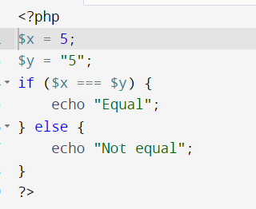
What will be the output of given code

Slide 11
Not Equal

Slide 12
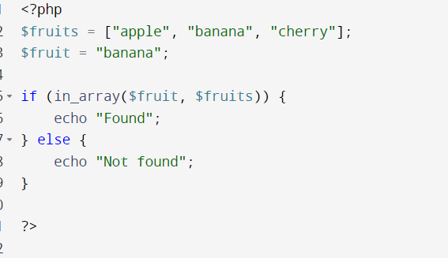
What will be the output of given code

Slide 13
Found

Slide 14
What is the difference between echo and print?
A. They both behave the same.
B. Print can take multiple parameters where as echo cannot
C. Echo can take multiple parameters where as print cannot
D. Print is a function where as echo is not.

Slide 15
What is the difference between echo and print?
A. They both behave the same.
B. Print can take multiple parameters where as echo cannot
C. Echo can take multiple parameters where as print cannot
D. Print is a function where as echo is not.

Slide 16
Which function is used to Strip whitespace (or other characters) from the beginning and end of a string?
A. trim_str
B. strip_str
C. strip
D. trim

Slide 17
Which function is used to Strip whitespace (or other characters) from the beginning and end of a string?
A. trim_str
B. strip_str
C. strip
D. trim

Slide 18
What is PHP heredoc used for?
A. allows creating single line of string without using quotations
B. allows creating multiple lines of string without using quotations
C. allows creating multiple lines of string with quotations
D. allows creating single lines of string with using quotations

Slide 19
What is PHP heredoc used for?
A. allows creating single line of string without using quotations
B. allows creating multiple lines of string without using quotations
C. allows creating multiple lines of string with quotations
D. allows creating single lines of string with using quotations

Slide 20
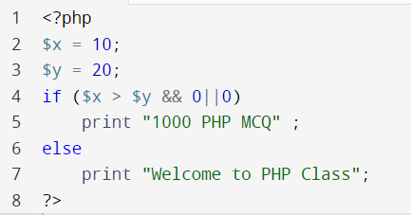
What will be the output of given code

Slide 21
Welcome to PHP Class

Slide 22
Which Function is used to check the length of the string
String_len
Str_len
String_length
String_len

Slide 23
Which Function is used to check the length of the string
String_len
Str_len
String_length
String_len

Slide 24
You have a PHP script with multiple if-else conditions. Which control structure can simplify your code and improve readability?
a) for loop
b) switch statement
c) while loop
d) do...while loop

Slide 25
You have a PHP script with multiple if-else conditions. Which control structure can simplify your code and improve readability?
a) for loop
b) switch statement
c) while loop
d) do...while loop

Slide 26
You want to create a PHP class that represents a "Car" with properties like "make," "model," and "color." Which OOP concept allows you to achieve this?
a) Inheritance
b) Abstraction
c) Encapsulation
d) Polymorphism

Slide 27
You want to create a PHP class that represents a "Car" with properties like "make," "model," and "color." Which OOP concept allows you to achieve this?
a) Inheritance
b) Abstraction
c) Encapsulation
d) Polymorphism

Slide 28
Which of the following functions is used to count the number of words in a string?
strlen()
strpos()
str_replace()
str_word_count()

Slide 29
Which of the following functions is used to count the number of words in a string?
strlen()
strpos()
str_replace()
str_word_count()

Slide 30
What is the following is the output of the following PHP code?
<?php
$str = "Hello, world!";
echo strpos($str, "world");
?>
7

Slide 31
Which function is used to find the number of elements in an array in PHP?
A) count()
B) length()
C) size()
D) sizeof()

Slide 32
Which function is used to find the number of elements in an array in PHP?
A) count()
B) length()
C) size()
D) sizeof()

Slide 33
In PHP, how do you check if a specific element exists in an array?
A) element_exists()
B) in_array()
C) array_search()
D) find_element()

Slide 34
In PHP, how do you check if a specific element exists in an array?
A) element_exists()
B) in_array()
C) array_search()
D) find_element()

Slide 35
Which array function is used to extract a portion of an array?
A) array_extract()
B) array_slice()
C) array_subarray()
D) array_part()

Slide 36
Which array function is used to extract a portion of an array?
A) array_extract()
B) array_slice()
C) array_subarray()
D) array_part()

Slide 37
Do this
Create an array with duplicate values and write a PHP script to remove duplicates and display the unique values.
Create an array of usernames. Write a script to check if a given username exists in the array or not

Slide 38
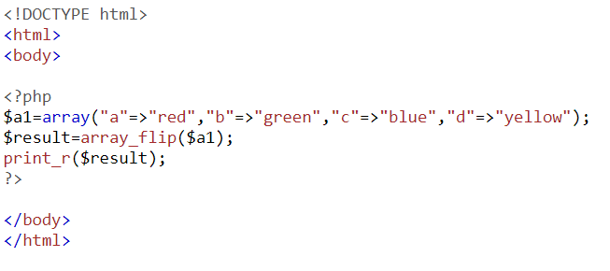

What is the usage of Array_flip

Slide 39
You want to declare a constant in PHP that represents the maximum file size allowed for uploads. Which keyword would you use to make it accessible throughout your code?
a) private
b) protected
c) public
d) const

Slide 40
You want to declare a constant in PHP that represents the maximum file size allowed for uploads. Which keyword would you use to make it accessible throughout your code?
a) private
b) protected
c) public
d) const

Slide 41
You need to create a PHP script that calculates the average of an array of numbers. Which looping construct is most suitable for this task?
a) for each
b) do...while
c) for
d) while

Slide 42
You need to create a PHP script that calculates the average of an array of numbers. Which looping construct is most suitable for this task?
a) for each
b) do...while
c) for
d) while

Slide 43
In a PHP class, you have a private property called "balance." Explain how encapsulation and OOP principles help ensure data integrity and security in this scenario.
a) Encapsulation ensures that the "balance" property can only be accessed by methods within the class, preventing unauthorized changes.
b) Encapsulation makes the "balance" property accessible to any part of the code, improving flexibility.
c) Encapsulation increases the risk of data leakage.
d) OOP principles have no impact on data security

Slide 44
In a PHP class, you have a private property called "balance." Explain how encapsulation and OOP principles help ensure data integrity and security in this scenario.
a) Encapsulation ensures that the "balance" property can only be accessed by methods within the class, preventing unauthorized changes.
b) Encapsulation makes the "balance" property accessible to any part of the code, improving flexibility.
c) Encapsulation increases the risk of data leakage.
d) OOP principles have no impact on data security

Slide 45
Which of the following is a valid PHP variable name?
A. $num
B. num
C. $123num
D. $num 1

Slide 46
Which of the following is a valid PHP variable name?
A. $num
B. num
C. $123num
D. $num 1

Slide 47
8. In an object-oriented PHP program, you have a parent class called "Shape" and two child classes called "Circle" and "Rectangle." Both child classes have a method named "calculateArea()." How does polymorphism apply in this scenario?
a) Polymorphism allows you to create objects of the "Shape" class only.
b) Polymorphism allows you to create objects of both "Circle" and "Rectangle" classes, and they can be used interchangeably when calling "calculateArea()."
c) Polymorphism prevents you from creating objects of child classes.
d) Polymorphism allows you to use the "Shape" class as a child of "Circle" or "Rectangle."

Slide 48
8. In an object-oriented PHP program, you have a parent class called "Shape" and two child classes called "Circle" and "Rectangle." Both child classes have a method named "calculateArea()." How does polymorphism apply in this scenario?
a) Polymorphism allows you to create objects of the "Shape" class only.
b) Polymorphism allows you to create objects of both "Circle" and "Rectangle" classes, and they can be used interchangeably when calling "calculateArea()."
c) Polymorphism prevents you from creating objects of child classes.
d) Polymorphism allows you to use the "Shape" class as a child of "Circle" or "Rectangle."

Slide 49
What will the output of the given code
<?php
$x = 0;
while ($x < 10) { $x += 1; } echo $x;?>
A. 10
B. 9
C. 8
D. None of the above

Slide 50
What will the output of the given code
<?php
$x = 0;
while ($x < 10) { $x += 1; } echo $x;?>
A. 10
B. 9
C. 8
D. None of the above

Slide 51
Write a example to showcase working of arrow function in PHP
What array function you used to sort associative array in ascending and descending order.
Asort() For ascending order according to value
Arsort() For decending Order according to value
Which array function is used to sort associative array according to key in descending order.
Krsort()
Which array function is used to sort associative array according to key in ascending order.
Ksort()

Slide 52
TRY THIS
Write a PHP script to sort the following associative array : array("Sophia"=>"31","Jacob"=>"41","William"=>"39","Ramesh"=>"40") in
a) ascending order sort by value b) ascending order sort by Key c) descending order sorting by Value d) descending order sorting by Key

Slide 53
What do you call the values that are passed into a function when it's called?
A) Parameters
B) Arguments
C) Variables
D) Constants

Slide 54
What do you call the values that are passed into a function when it's called?
A) Parameters
B) Arguments
C) Variables
D) Constants

Slide 55
When calling a user-defined function in PHP, which of the following is true regarding the number of arguments passed?
A) You must always pass the same number of arguments as there are parameters in the function definition.
B).No need to pass arguments
C) You can pass fewer arguments than there are parameters in the function definition.
D) You can pass more arguments than there are parameters in the function definition.

Slide 56
When calling a user-defined function in PHP, which of the following is true regarding the number of arguments passed?
A) You must always pass the same number of arguments as there are parameters in the function definition.
B).No need to pass arguments
C) You can pass fewer arguments than there are parameters in the function definition.
D) You can pass more arguments than there are parameters in the function definition.

Slide 57
Kavya wants to throw a pizza party with her friends. She cooks pizza for them; now she wants her pizzas divided into eight slices each and distributed evenly among her friends.
Create a function that
It takes a number of pizzas and a number of friends.
and returns the number of slices that will be left over if each person takes an equal number of slices.

